Slide 1
Committee on Inspection and Observation Committee
Guðni Magnús Eiríksson (IS)
Chair

Slide 2
CIO - item 7.1 Report of the Committee on Inspection and Observation
NAMMCO/28/10
Committee members:
FO: Ulla Svarrer Wang
GL: Sofie Abelsen, Jesper Ødegaard Jakobsen, Amalie Jessen and Nette Levermann (until July 2020)
IS: Guðni Magnús Eiríksson (chair)
NO: Guro Gjelsvik (from 2021) and Hild Ynnesdal
CIO meetings:
2019: 21 May and 1-2 October
2020: 16 January, 8 and 18 February, 3 April, 6-8 October and 26 November
2021: 16-17 February

Slide 3
NAMMCO/28/10
CIO - item 7.1 Report of the Committee on Inspection and Observation
EVALUATION OF THE OBSERVATION SCHEME
To meet one of the objectives of the scheme, CIO agreed to review the compliance of member countries to recommendations given by NAMMCO.
In current NAMMCO Observer Scheme: “Provide a mechanism for NAMMCO to oversee whether recommendations made by NAMMCO are implemented and national regulations are adhered to”
A first step has been to review the document “Overview of Recommendations from CHM Workshop and Expert group meetings”.
Reviewing all recommendations and responses and having classified them according to whether they are completed or active, the CIO will continue to consider if this overview may be used as a tool to obtain quantitative information about member countries responses to recommendations. A first step will be to investigate if and how statistical information can be extracted in an efficient manner.

Slide 4
CIO - item 7.1 Report of the Committee on Inspection and Observation
NAMMCO/28/10
OBSERVER TRAINING COURSE
The CIO organised a training course in Iceland for observer candidates 5-7 February 2020.
The three-day programme covered presentations on NAMMCO as an organisation, the Observation Scheme, the different hunts and relevant regulations with examples of check lists, observers sharing their experiences on being out in the field and administrative conditions such as contracts and remuneration.
The CIO viewed the course as more dynamic and interactive compared to the course which was held in 2013. Discussing the cost/benefit of similar courses, the CIO recommended reconsidering the format, while keeping in mind that the language barrier remains the main challenge.
The CIO has agreed to organise annual online meetings with the observers to update the corps on new developments and activities in NAMMCO. The first meeting was held 12 November 2020.

Slide 5
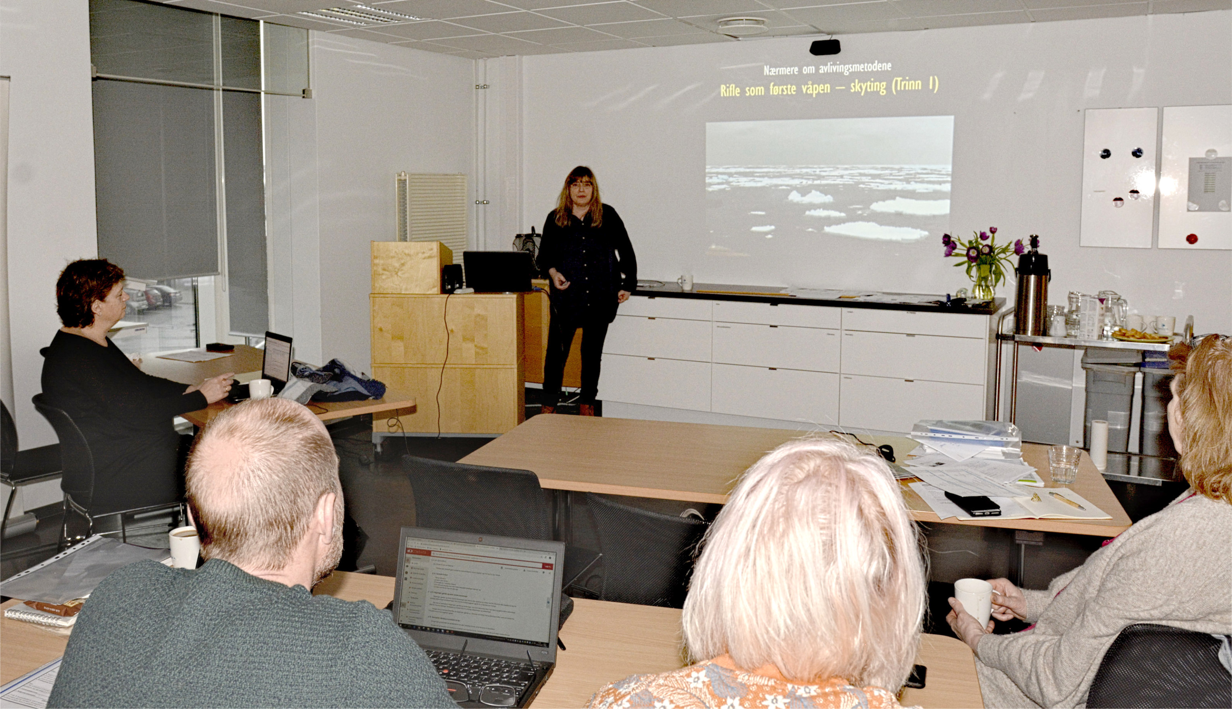

Slide 7
CIO - item 7.1 Report of the Committee on Inspection and Observation
NAMMCO/28/10
ACTION REQUESTED
The redundance of Section A of the Provisions of the Joint NAMMCO Control Scheme (item 7.2)
• The guidelines to the Observer Scheme (item 7.2.2)
• The amended text of paragraph 5 for the Observer Scheme
• The new rates for remuneration of observers
• The appointment of observers to the corps
• The Scopes for 2021 and 2022 observation activities (item 7.3 & 7.4)
Amendment to the Rules of Procedure of the CIO

Slide 8
CIO - item 7.1 Report of the Committee on Inspection and Observation
NAMMCO/28/10
THE AMENDED TEXT OF PARAGRAPH 5 FOR THE OBSERVATION SCHEME
The CIO recommends that the guidelines as found in document NAMMCO /28/16 be adopted by the Council (item 7.2.2).
To streamline the text of the Observation Scheme with the proposed guidelines the CIO recommends changing the text of paragraph 5 of the Observation Scheme as follows:

Slide 9
CIO - item 7.1 Report of the Committee on Inspection and Observation
NAMMCO/28/10
THE NEW RATES FOR REMUNERATION OF OBSERVERS
The current remuneration rates for observers were revised in 2008 based on the rates for national inspectors in the member countries at that time. The CIO agreed to recommend that these be adjusted for Norwegian inflation rates backdating to 2008. The new recommended rates are:
NOK 3 000 per day when at sea. Currently NOK 2 400.
NOK 2 276 per day when land based. Currently NOK 1 800.
NOK 2 900 as a lump sum. Currently NOK 2 300
The recommended rates have been approved by FAC

Slide 10
CIO - item 7.1 Report of the Committee on Inspection and Observation
NAMMCO/28/10
THE APPOINTMENT OF OBSERVERS TO THE CORPS
Previously, observers have been nominated and approved every year. One of the recommended changes in the guidelines to the Observation Scheme is to have a corps of observers to draw from to avoid a bureaucratic annual procedure.
Council approved all nominated observer candidates for the year 2021 by correspondence 30 October 2020. The CIO recommends that Council extends this approval to be an approval of all the candidates to be members of the observation corps in line with the recommended guidelines NAMMCO/28/16.
All candidates are listed in NAMMCO/28/11 Appendix 2.

Slide 11
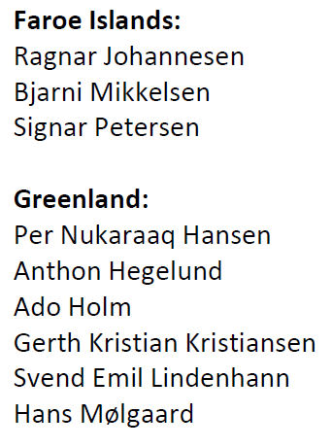
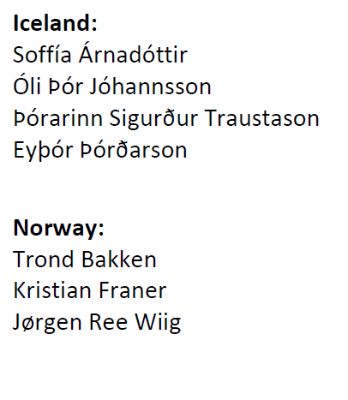
CIO - item 7.1 Report of the Committee on Inspection and Observation
NAMMCO/28/10
Nominated observer candidates:
In recommended Guidelines:
Appointment of observers
The NAMMCO Council approves and appoints observers. An approved observer will continue to function in the role until his/her services are withdrawn/cancelled by either personal notification or notification by the (nominating) member country.
Member countries are required to contribute a minimum of two candidates to the corps of observers.

Slide 12
CIO - item 7.1 Report of the Committee on Inspection and Observation
NAMMCO/28/10
TERMS OF REFERENCE OF THE CIO
The adoption of the Observation Scheme requires changes to the Terms of Reference (ToR) as described in the Rules of Procedure (RoP) for the CIO. The CIO also proposes that, should the Council endorse the recommendations put forward under item 7.2.1, the ToR should be amended to include a reference to national inspection schemes.
Strengthen transparency and clarity, it was seen as expedient to include a reference to national inspection schemes and the CIOs mandate to give advice on these should Council require this. Recommended new text of the Terms of Reference in the CIO Rules of Procedure (NAMMCO 28/10 - Appendix 1)
To be addressed by Council at later date.

Slide 13
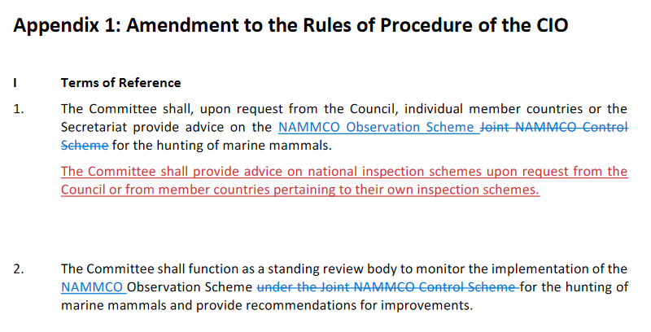
CIO - item 7.1 Report of the Committee on Inspection and Observation
NAMMCO/28/10

Slide 14
CIO - item 7.2 Revisions to the Inspection and Observation Scheme
NAMMCO/28/10
7.2.1 Section A
7.2.2 Section B

Slide 15
CIO – item 7.2.1 Section A on common elements of national inspections
NAMMCO/28/10
Reviewing Section A (see NAMMCO/28/FI04), the CIO agreed that these guidelines were outdated in the sense that most of the elements are de facto incorporated in today’s national inspection schemes for the hunts in question (hunting with harpoon gun). It was also noted that national inspection systems usually build on international fisheries standards, and that there is no apparent need to reinvent the wheel.
When Section A was developed, it was designed to give inspectors the possibility to collect scientific data. However, the reality is that data identified as important for the work of the scientific committee and other committees have been collected through other channels.
Concluding its review of Section A, the CIO recommends that Section A is redundant and the CIO there is no proposal for developing common elements for member countries national inspection schemes of other hunts.
Recommendation to Council: Section A is redundant today

Slide 16
Section B: Guidelines to the Observation Scheme– item 7.2.2
NAMMCO/28/10
The general principle is that member countries are responsible for nominating observer candidates that meet the agreed requirements related to safety courses and certificates.
The qualification requirements, including requirements for safety training and health certificate, have been identified and described in the CV templates for observer candidates.
The nomination- and appointment procedure has been revised to reflect the establishment of a corps of observers. An approved observer will continue to function in the role until his/her services is withdrawn/cancelled by either personal notification or notification by the (nominating) member country.
A procedure for identifying and approving the scope has been agreed.
How to report on the Observation Scheme has been described and a plan for how the hunt specific checklists will be developed has been agreed.
Recommendation to Council: Adopt the guidelines as described in NAMMCO/28/16

Slide 17
CIO - item 7.3: Observation activities in 2021 and 2022
NAMMCO/28/10
FAC October meeting asked CIO for information on the added value of NOK 200,000 for Observation Scheme
Added value for the Scheme – more observations
Purpose to collect reliable information on hunting activities
Observations
Review of national regulations (CIO)
With the scope defined, need to maximise the outcome of the allocated budget
Identify location and times of year giving the highest probability of successfully observing target hunts
Added value for NAMMCO
Signals that NAMMCO continues to support the scheme
That it is of high importance to its members
NAMMCO continues to invest in the scheme at the same level and without reduction and is committed to ensuring that the hunts taking place within its area are sustainable and responsible and that observation activities have an important role in monitoring this.
Financial aspects
Costs that vary with the number of observers but are independent of the duration of the assignment (i.e. travel costs to and from and internally in the country of focus, cost of insurance and equipment)
Costs that vary with the duration of the assignment and increase per contract day (i.e. honoraria, per diem and accommodation costs)

Slide 18
Observations 2022: budget scenarios – item 7.3
NAMMCO/28/10
OPTIONS | Options 1 -5 below budget | Current budget option 6 | 7 | 8 | 9 | 10 | 11 | Recommended option 12 | 13 | 14 | 15 | 16 | 17
Number of observers |  | 2 observers |  | 3 observers |  |  |  |  |  |  | 4 observers
Total number of weeks |  | 9 weeks | 10 weeks | 9 weeeks | 10 weeks | 11 weeks | 12 weeks | 13 weeks | 14 weeks | 15 weeks | 12 weeks | 14 weeks | 16 weeks
Contract days |  | 63 | 70 | 63 | 70 | 77 | 84 | 91 | 98 | 105 | 84 | 98 | 112
Travel days incl. Nuuk 1 day |  | -10 | -10 | -15 | -15 | -15 | -15 | -15 | -15 | -15 | -20 | -20 | -20
Observation days |  | 53 | 60 | 48 | 55 | 62 | 69 | 76 | 83 | 90 | 64 | 78 | 92
Honoraria (NOK 2,276 ) |  | 143,388 | 159,320 | 143,388 | 159,320 | 175,252 | 191,184 | 207,116 | 223,048 | 238,980 | 191,184 | 223,048 | 254,912
Per diem (NOK 500) |  | 31,500 | 35,000 | 31,500 | 35,000 | 38,500 | 42,000 | 45,500 | 49,000 | 52,500 | 42,000 | 49,000 | 56,000
Accommodation (NOK 900) |  | 54,900 | 61,200 | 54,900 | 61,200 | 67,500 | 73,800 | 80,100 | 86,400 | 92,700 | 73,800 | 86,400 | 99,000
Return travel (NOK 20,000) |  | 40,000 | 40,000 | 60,000 | 60,000 | 60,000 | 60,000 | 60,000 | 60,000 | 60,000 | 80,000 | 80,000 | 80,000
Travel within Greenland (NOK 5,000) |  | 10,000 | 10,000 | 15,000 | 15,000 | 15,000 | 15,000 | 15,000 | 15,000 | 15,000 | 20,000 | 20,000 | 20,000
Insurance (NOK 5,000) |  | 10,000 | 10,000 | 15,000 | 15,000 | 15,000 | 15,000 | 15,000 | 15,000 | 15,000 | 20,000 | 20,000 | 20,000
Equipment (per observer: NOK 2,900) |  | 5,800 | 5,800 | 8,700 | 8,700 | 8,700 | 8,700 | 8,700 | 8,700 | 8,700 | 11,600 | 11,600 | 11,600
Total cost |  | 295,588 | 321,320 | 328,488 | 354,220 | 379,952 | 405,684 | 431,416 | 457,148 | 482,880 | 438,584 | 490,048 | 541,512
Average cost of one observation day |  | 5,577 | 5,355 | 6,844 | 6,440 | 6,128 | 5,879 | 5,677 | 5,508 | 5,365 | 6,853 | 6,283 | 5,886
Added budget above NOK 300,000 |  |  | 21,320 | 28,488 | 54,220 | 79,952 | 105,684 | 131,416 | 157,148 | 182,880 | 138,584 | 190,048 | 241,512
Extra days gained compared to a NOK 300,000 budget |  |  | 7 | - 5 | 2 | 9 | 16 | 23 | 30 | 37 | 11 | 25 | 39
Cost of added days pr day |  |  | 3,046 |  | 27,110 | 8,884 | 6,605 | 5,714 | 5,238 | 4,943 | 12,599 | 7,602 | 6,193

Slide 19
Setting the scope for observation – item 7.3
NAMMCO/28/10
In previous years, the scope of observations was mostly chosen based on a principle of rotation between member countries and hunts. Within the new Observation Scheme, the CIO has identified the following additional criteria for deciding the observation focus in a year:
Hunting level
Hunts not covered by national inspectors
Hunts for which the SC or CHM request data (e.g., on struck and lost)
Maximising the effort to reach the objectives of the Scheme by allocating money from several years into one year.
Hunts that are not a priority:
Small scale hunts occurring infrequently and in remote areas
Hunts not practically feasible for observation due to specific hunting methods or other aspects

Slide 20
Proposed Scope 2022 – item 7.3
NAMMCO/28/10
Walrus, narwhal and beluga hunts in West Greenland carried out with rifles and handheld harpoons from dinghies/small boats.
The East Greenland catches are few compared to West Greenland. For walrus, the average reported catches of the last six years (2015-2020) have been 5% of a total of 693 animals and 17 % of a total of 2,463 narwhals. Also, the narwhal quotas for 2021 have been reduced significantly. The proposal is therefore to focus on West Greenland to utilise the observer resources most efficiently.
The targeted hunting method, rifle with handheld harpoon, has been identified by NAMMCO as a method of concern given the reported relatively longer times to death and the lack of reliable struck and lost information.
It is impossible to find one location and period that coincides for all three hunts. The following proposal for locations, timing and hunts are informed by reported catch statistics from previous years (2015-2020).
Sisimiut in March – April: Beluga
Sisimiut in March – April: Walrus
Upernavik in April – May: Narwhal
Uummannaq in October – November: Narwhal
Upernavik in in October – November: Beluga
Recommendation to Council: Approve the scope and range of the Observation activities in 2022

Slide 21
NAMMCO/28/10
CIO - item 7.4
Adoption of priorities and work plan 2021-2022
Alternatives and CIO recommendations from priorities and work plan 2021-2022
No NAMMCO observation activity for 2021, due to COVID-19
In 2022: Walrus, narwhal and beluga hunts in West Greenland carried out with rifles and handheld harpoons from dinghies/small boats.
Budget option 6: 295,588 NOK; Current budget
Budget option 12: 431,416 NOK; CIO recommended

