Slide 1
SCIENTIFIC COMMITTEE JOINT WORKING GROUP ON NARWHAL AND BELUGA Beluga Assessment
Roderick Hobbs
Chair of the JWG
Notes:
In Late October 2020 the Joint Working Group on Narwhal and Beluga (JWG) Meet online for five 3 hour sessions. It was determined that the narwhal assessment would require additional analysis that could not be completed during the week of the meeting so this was assigned to a quantitative sub-group to complete for a meeting in September or later. An assessment was completed for the West Greenland beluga hunts that is presented here.

Slide 2
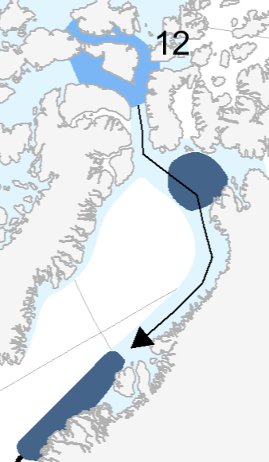
High Arctic-Baffin Bay Belugas
Somerset Is.
Belugas in this stock summer in the waters around Somerset Island in the Canadian Arctic. Satellite tracking shows that in the fall they migrate east into the North Water Polynya and then south along the coast of Greenland to the area around Disco Bay. Returning in the late spring.
Belugas are seen on aerial surveys and hunted in the North Water and Qaanaaq area throughout the year suggesting that there is a resident population in the area.
North Water
Qaanaaq
Disco Bay
Notes:
The belugas hunted in West Greenland are considered to be in the High Arctic-Baffin Bay stock. This stock summers in the waters around Somerset Is. in the Canadian Arctic. In the fall they migrate east into the North Water Polynya and then south along the coast of Greenland to the area around Disco Bay. Returning in the late spring. Hunting occurs on the summering grounds at various points during the fall and spring migrations and in wintering areas. Belugas are seen on aerial surveys and hunted in the North Water and Qaanaaq area throughout the year suggesting that there is a resident population in the area.
Previous assessments have treated all of West Greenland as a single management area however at the request of Greenland we have provided separate advices for hunting in the North Water area (Qaanaaq) and the other areas of West Greenland further south.

Slide 3
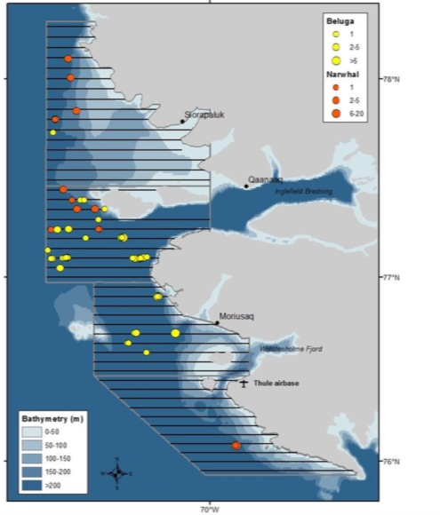
April 2018 Aerial Survey
Survey covered open water areas of the eastern portion of the North Water Polynya. Tracklines are in black.
Sightings of belugas (yellow) and narwhals (orange).
Notes:
The North Water was most recently surveyed in April 2018. The survey covered open water areas of the eastern portion of the North Water Polynya. Tracklines are in black.
Sightings of belugas (yellow) and narwhals (orange).

Slide 4
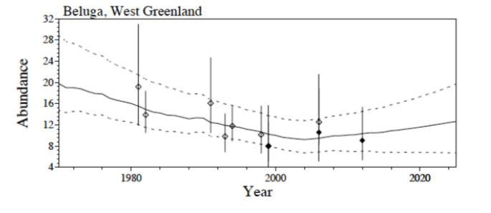
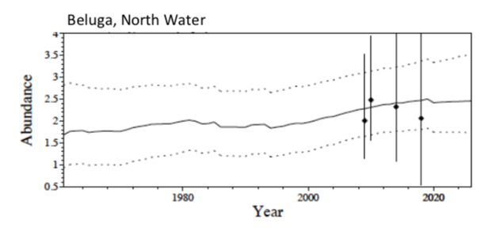
Assessment Model Results
Notes:
These are the distributions of population trajectories from the model analyses that were used for the assessment. The top chart models the West Greenland beluga population which is hunted by all communities from Savissivik south to the main wintering grounds south of Disco Bay. The solid line is the median projection, the dashed lines are the 5% and 95% percentiles of these distributions. The projections for 2020 and beyond assume that the recent levels of removals continue. The catch history was re-estimated to include catches only from Savissivik and south, separating the stock component that winter in West Greenland from the component in the North Water. Assuming an initial abundance below carrying capacity, the model estimates a population of 19,800 (90% CI: 14,700–28,800) individuals wintering in West Greenland in 1970. The projection declined initially by 54% (90% CI: 68%–35%) to an abundance of 9,250 (90% CI: 6,730–12,800) animals in 2004. It then increased by 37% (90% CI: -18%–93%) to 10,900 (90% CI: 6,280– 16,500) individuals in 2021.
The lower chart is the assessment model runs for the aggregation of beluga in the North Water, treating it as a separate stock, and following the same premises and modeling framework as applied to West Greenland beluga over the past 15 years. The assessment includes four fully corrected abundance estimates from 2009 to 2018, and it assumes that catches taken north of Cape York relate to the stock component of beluga in the North Water.
The population model estimates an abundance of 1,690 (90% CI:932–2,820) beluga in 1961, with an increase to 2,300 (90% CI:1,640–3,200) individuals in 2021.

Slide 5
Probability of Increase for Landed Catch Levels *
Probability of Meeting Management Objectives | Landed Catch of Belugas in West Greenland | Landed Catch of Belugas in Qaanaaq
0.5 | 354 | 44
0.55 | 333 | 42
0.6 | 313 | 41
0.65 | 289 | 39
0.7 | 265 | 37
0.75 | 242 | 36
0.8 | 217 | 34
0.85 | 186 | 31
0.9 | 154 | 29
0.95 | 113 | 23
* Following request 1.6.5 from the NAMMCO Council (2017) the JWG has provided advice with recommendations on total landings instead of total removals as was done in earlier assessments.
Notes:
To maintain a 70% probability for population increase, the assessment for West Greenland recommends an annual landed catch of no more than 265 individuals south of Cape York and north of 65 degrees N.
. For Qaanaaq, the North Water population, to maintain a 70% probability for population increase, the assessment for the North Water recommends an annual landed catch of no more than 37 individuals north of Cape York.

Slide 6
Additional Advice for West Greenland
The JWG reiterated advice from 2005 and 2012 (amended to account for the new North Water assessment) and recommended the following seasonal closures:
Northern (Uummannaq, Upernavik, Savissivik): June through August
Central (Disko Bay): June through October
Southern (South of Kangaatsiaq): May through October.
Furthermore, the JWG also reiterated its previous recommendation that for the area south of 65°N, no harvesting of beluga be allowed at any time.
The function of these closures is to protect the few beluga that may remain from historical summer aggregations in Greenland, and to allow for the possibility of reestablishment of the aggregations.

Slide 7
Additional Advice for Qaanaaq (North Water)
Earlier recommendations that belugas should be protected in Qaanaaq during summer (July-August) due to the scarcity of animals in the area in that season and the uncertainty of which stock they originated from are now revised in light of this presumed North Water stock. The JWG now recommends that any landed catches during the summer as well as other seasons should be counted against the same North Water stock quota.
Notes:
Thanks and are there any questions?

