Slide 1
SCIENTIFIC COMMITTEE AD HOC WORKING GROUP ON NARWHAL IN EAST GREENLAND
Roderick Hobbs
Chair of the NEGWG
Notes:
The NAMMCO Scientific Committee has expressed concern over the status of narwhal stocks in East Greenland due to high catches continuing on a declining population. In September 2019 an Ad hoc Working Group (WG) on Narwhal in East Greenland was convened. This WG met at the Greenland Representation in Copenhagen.
The tasks for the WG involved reviewing data on stock structure, abundance and distribution; examining impacts from hunting, climate change and other human sources; and assessing the future sustainability of catches.

Slide 2
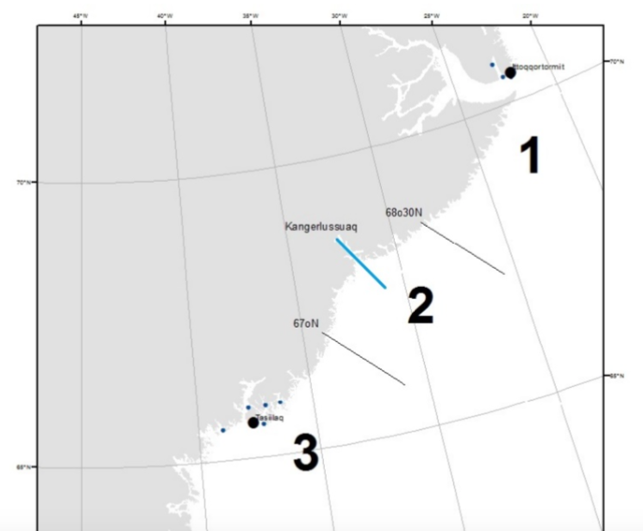
Distribution & Stock Structure
Three proposed management areas for narwhals in East Greenland.
¹⁾ Ittoqqortoormiit & Scoresby Sound
^{2) Kangerlussuaq}
^{3) Tasiilaq}
^{Blue line indicates the} previous segregation of two management areas.
Blue dots represent settlements, with Tasiilaq and Ittoqqortoormiit superimposed.
Notes:
Three management areas had previously been recommended for narwhals in East Greenland based on the known high degree of site fidelity, the observed distribution during summer, and to facilitate a precautionary approach to management. The management areas considered by the WG were therefore: Area 1 = Ittoqqortormiit, Scoresby Sound and Blosseville Coast south to 68°30’N; Area 2 = Kangerlussuaq 68°30’N to 67°N; Area 3 = Tasiilaq, south of 67°N. Genetic analysis shows that East Greenland narwhals are distinct from narwhals in West Greenland and from those in Svalbard. The analysis requires additional samples to distinguish among stocks within East Greenland.

Slide 3
Distribution & Stock Structure
Tracks of two narwhals tagged in Hjørnedal near hunting grounds in late summer. These narwhal moved out of the fjord system in early November and stayed in offshore areas south of Scoresby Sound through winter and spring until mid June when their transmitters stopped.
Ittoqqortoormiit
Notes:
There is some uncertainty regarding stock structure in Management Area 1 (Ittoqqortoormiit /Scoresby Sound). Specifically, whether this area is inhabited by two populations at different times of the year. This possibility is indicated by the seasonal distribution of catches as well as tracking data. Narwhals tagged in Hjørnedal near hunting grounds in summer moved out of the fjord system in fall and stayed in offshore areas south of Scoresby Sound through winter and spring. This map shows two tracks and as you can see, both whales moved out of Scoresby Sound in early November and neither had returned by mid June when their transmissions ceased. During April-June catches are reported at the ice edge outside Ittoqqortoormiit while these tagged whales were offshore. This suggests two possibilities: 1) there is a second population in Scoresby Sound that does not enter the tagging area during summer and remains in the northern Sound during spring, or 2) there is migration down from a population in the north (e.g. Dove Bay). There is currently no evidence to support either of these over the other and further work is required to resolve stock structure in this area.
.

Slide 4
2016 Aerial Survey Scoresby Sound to Tasiilaq
The survey was conducted during 17 to 25 August 2016 covering the fjord system of Scoresby Sound, a sample of the fjords along the Blosseville Coast, the Kangerlussuaq fjord, the fjords south of 65°N and some coastal areas (black lines).
Red dots indicate locations of narwhal sightings.
Notes:
An aerial survey of the entire hunting region was conducted in August of 2016. This survey covered the same areas as the 2008 survey. The black lines indicate survey tracks and the red dots indicate sightings of narwhals. Narwhals were seen in Scoresby Sound, a few of the fjords along the Blosseville Coast and in the Kangerlussuaq fjord area. Narwhals were not detected south of the Kangerlussuaq fjord area in Management Area 3. Abundance was estimated for Areas 1 and 2; abundance could not be estimated for Area 3 owing to the lack of detections.

Slide 5
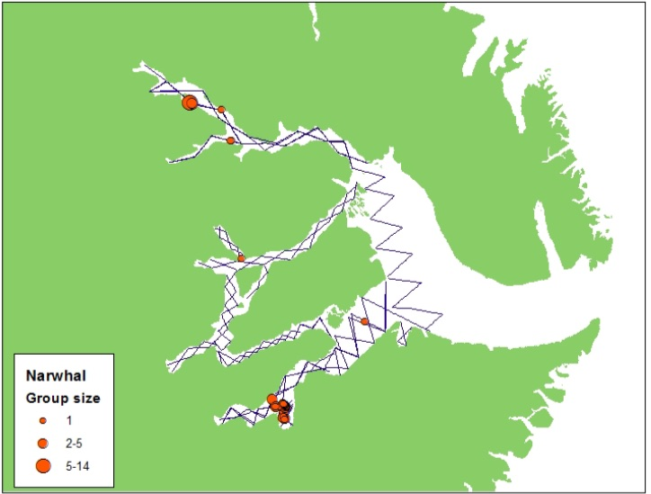
2017 Survey of Scoresby Sound
Black lines are survey tracklines.
^{Red dots indicate locations of}
^{narwhal sightings.}
Notes:
In August 2017 Scoresby Sound was surveyed, repeating the tracklines flown in the 2016 survey. Narwhal sightings in this survey were distributed in a pattern similar to those in the 2016 survey.

Slide 6
Abundance Estimated for Each Management Area (%CV)
Year | Scoresby Sound only | Area 1 Ittoqqortoormiit Scoresby Sound & south to 68°30’N | Area 2 Kangerlussuaq & 68°30’N to 67°N | Area 3 Tasiilaq & south of 67°N
1983 | 1180 (34)
1984 | 401 (58)
2008 |  | 1940 (57) | 613 (71) | 206 (55)
2016 |  | 433 (49) | 269 (37) | ***
2017 | 246 (43)
Notes:
Abundance estimates result from two complete surveys of the Southeast Greenland narwhal stock conducted in 2008 and 2016. Results from these surveys have been divided into the three proposed Management Areas. In addition there have been three surveys of Scoresby Sound which are used in the assessment for Area 1. The numbers in parentheses are the Coefficient of Variation of each estimate (as a percentage). Note that there is a substantial decline in Areas 1 and 2 between 2008 and 2016. *** indicates that an estimate could not be completed.

Slide 7
Total Removals by Year for Each Management Area 2010-2019
Year | Total Catch in Area 1 | Total Catch in Areas 2 & 3 | Catch in Area 2 | Catch in Area 3 | Total Removals Area 1 | Total Removals Area 2 | Total Removals Area 3
2010 | 16 | 25 |  |  | 25 | 16 | 14
2011 | 30 | 15 | 14 | 1 | 37 | 17 | 1
2012 | 31 | 17 | 2 | 14 | 39 | 2 | 17
2013 | 47 | 19 | 2 | 14 | 59 | 2 | 17
2014 | 63 | 18 | 11 | 2 | 82 | 13 | 2
2015 | 74 | 20 | 11 | 2 | 82 | 13 | 2
2016 | 38 | 15 | 0 | 14 | 50 | 0 | 17
2017 | 60 | 33 | 21 | 3 | 74 | 25 | 4
2018 | 51 | 23 | 15 | 3 | 67 | 18 | 4
2019 | 50 | 17 | 3 | 10 | 61 | 4 | 12
Average | 46 | 20.2 | 7.9 | 6.6 | 58.4 | 11.2 | 9.4
Notes:
The catch history for this stock goes back to 1955, these are the most recent 10 years. Catches were reported for Ittoqqortoormiit which included Scoresby Sound and the northern Blosseville Coast (Area 1), and Tasiilaq which also included Kangerlussuaq (Areas 2 and 3). In most cases the reports from hunters after 2011 included the location so that the Tasiilaq hunt could be divided into Areas 2 and 3. For years prior to 2011 the takes were divided using the proportion from the years 2011 and later. Corrections for struck and lost depending on the hunting method were applied to the catches to estimate the Total removals.

Slide 8
Pregnancy Rate in Area 1
Notes:
Hunters report the sex, estimated age and for females whether a fetus was present. Pregnancy rates were calculated from the fraction of females removed after 1st August with a fetus (yes=9; no=69; data from Special Reports). At 1st Aug the fetuses are ~20 cm in length, in June and July the fetus is smaller and may be overlooked by the hunter.
The annual percentage of pregnant females caught in Area 1 after 1st August during the years 2011–2019 has declined substantially from around 30%, which we expect from a healthy narwhal population, to zero in recent years. This supports the report from the 2017 survey in which it was noted that very few calves were seen.

Slide 9
Habitat Changes & Population Responses
Major oceanographic changes have occurred in Southeast Greenland
Lack of pack ice in the summer.
Increasing sea temperatures.
Resulting effects in the marine ecosystem include:
Changes in fish fauna and distribution.
Arrival of large numbers of boreal cetaceans either new to the area or in much larger numbers (e.g. humpback, fin, killer, and pilot whales as well as white- beaked dolphins).
Narwhals are dependent on cold water and have limited ability to dissipate heat and thus can not easily adapt to these warming temperatures.
Changes in fish fauna mean that narwhal's preferred prey may be displaced.
Arrival of new cetacean species means increased competition for prey, predation by killer whales, and exposure to novel diseases and parasites.
Recently narwhals have been seen in areas north of their traditional range (e.g. Dove Bay), suggesting that new narwhal habitat is becoming available to the north as habitat is lost in Southeast Greenland.
Notes:
Two major oceanographic changes have been observed in coastal areas of Southeast Greenland - a lack of pack ice in summer and increasing sea temperatures. This has had cascading effects on the marine ecosystem, including changing fish fauna and the presence of a large number of boreal cetaceans either new to the area or now occurring in surprisingly large numbers (e.g. humpback, fin, killer, and pilot whales as well as white- beaked dolphins). This leads to loss of preferred prey, competition, predation and exposure to novel pathogens and parasites.
Narwhals are endemic to the Arctic and depend on cold water. Their habitat range is therefore being restricted by the warming oceans. Since they primarily get rid of heat through the dorsal ridge and tail fluke, their ability to adapt to these warming temperatures is also limited. There have recently been several sightings of narwhals in areas north of their traditional range (e.g. Dove Bay), suggesting that new narwhal habitat is becoming available to the north as habitat is lost in Southeast Greenland. While evidence suggests that a combination of hunting and climate change is negatively impacting the long-term viability of narwhal populations in Southeast Greenland further research is needed before we can include these impacts in the assessment models.

Slide 10
Population Models for the Assessment
Notes:
These are the distributions of population trajectories from the model analyses that were used for the assessment. The top chart models the population in Management Area 1. This model used the two complete abundance estimates and the three estimates for Scoresby Sound multiplied by a factor to account for the portion of the population outside of the survey area. Also for Area 1 the pregnancy rate shown earlier and the age structure of the removals could be used to improve the correspondence of the model to the actual population. The solid line is the median projection, the dashed lines are the 5% and 95% percentiles of these distributions. The projections for 2020 and beyond assume the the recent levels of removals continue. As you can see the model shows a declining population and predicts that the population will be extirpated in 5 to 10 years if the removals continue as they are. Pregnancy rate and age structure data were not available for Areas 2 and 3 thus a simpler model was used which assumes that the population will only decline if the removals are too large.

Slide 11
Parameter Estimates
Parameter | Area 1 Ittoqqortoormiit Scoresby Sound & south to 68°30’N | Area 2 Kangerlussuaq & 68°30’N to 67°N | Area 3 Tasiilaq & south of 67°N
2019 Population Size | 410 (120, 992) | 288 (136, 557) | 206 (30, 669)
Current Growth Rate %/yr | 0.1 (-1.0,1.9) | 2.5 (0.3, 5.5) | 2.6 (0.4, 4.9)
Depletion Level % | 18.4 (5.8, 40.5) | 27.0 (11.8, 58.2) | 24.8 (3.8, 74.1)
1955 Population Size | 2290 (1750, 2840) | 1050 (723, 1540) | 824 (578, 1210)
Notes:
These are the key parameters for the three Management Areas, the number is the median estimate and in parentheses are the 90% range of the distribution. The estimated population sizes for each area are small. The estimate for Area 3 is 206 which is based on the survey estimate from 2008, it is likely that this would be lower if there was an estimate from the 2016 survey. The working group discussed methods to use the lack of sightings with the survey effort to estimate the likelihood of various population sizes and recommended that this approach be developed for the next meeting.
The model estimated the median growth rate in Area 1 to be very close to zero and possibly negative indicating that the level of removals is not the only reason for the population decline. The growth rates for Areas 2 and 3 were estimated to be higher but as noted earlier these models did not include life history information and thus may be optimistic.
Each of these populations were found to be substantially depleted from much larger population sizes in 1955.

Slide 12
Probability of Increase
Annual Removals | Area 1 Ittoqqortoormiit Scoresby Sound & south to 68°30’N | Area 2 Kangerlussuaq & 68°30’N to 67°N | Area 3 Tasiilaq & south of 67°N
1 | 0.57 | 0.94 | 0.88
2 | 0.48 | 0.86 | 0.76
3 | 0.4 | 0.79 | 0.66
4 | 0.32 | 0.72 | 0.58
5 | 0.28 | 0.65 | 0.52
6 | 0.22 | 0.57 | 0.46
7 | 0.18 | 0.5 | 0.41
8 | 0.15 | 0.44 | 0.36
9 | 0.13 | 0.37 | 0.33
10 | 0.11 | 0.32 | 0.29
Notes:
As in previous assessments the objective was to determine a level of annual removals that is sustainable and for narwhals we have used the criterion that the population should have a 70% probability of increase despite the removals. Note that for Area 1 there is no level of removals that would allow the population to increase with 70% probability, thus the WG concluded that no level of removals would be sustainable. For Kangerlussuaq the estimated probability of increase is 72% should 4 individuals be removed annually. The working group considered this estimate to be too optimistic because demographic variation, Allee effects, and other factors, which negatively affect small populations, as well as climate change were not included in the model but should be taken into account when considering the sustainability of the harvest. For Tasiilaq the estimated probability of increase is 76% should two individuals be removed annually. As for Kangerlussuaq this estimate is considered to be too optimistic, and additionally because of a statistical bias (the model abundance lacked a result from the 2016 survey). For Kangerlussuaq and Tasiilaq with the additional considerations, the WG concluded that no level of removals would be sustainable.

Slide 13
Recommendations for Conservation & Management
The NAMMCO SC seek an immediate response from managers to the information that current removal levels are unsustainable.
The NAMMCO SC develop guidance on a standard or principle-based approach for management and harvest advice for small stocks.
Data on struck and lost be obtained to inform assessments of sustainability if any harvest continues.
Reports of landed animals include the length of the animal in addition to the age category and presence of a fetus.
Hunters receive payment for assisting scientific research to clarify stock structure and abundance (e.g. through tagging animals).
Ways to improve the reporting of user observations (e.g. on struck and lost, pregnancies, stomach contents, and seasonal presence) be investigated to inform future assessments.
The negative impact of climate change on narwhals be recognized and included in management decision-making on all stocks.
Notes:
The WG developed a list of Recommendations, of particular importance for this presentation are the first two. The WG considered that even one additional year of the recent levels of removal could have a substantial impact on the viability of this stock. The WG found the current criteria for sustainable removals to be in adequate and requests guidance on how to assess sustainability when a population is substantially depleted and/or small as is the case for the Southeast Greenland narwhals.
Thank you, Are there any questions?

