Slide 1
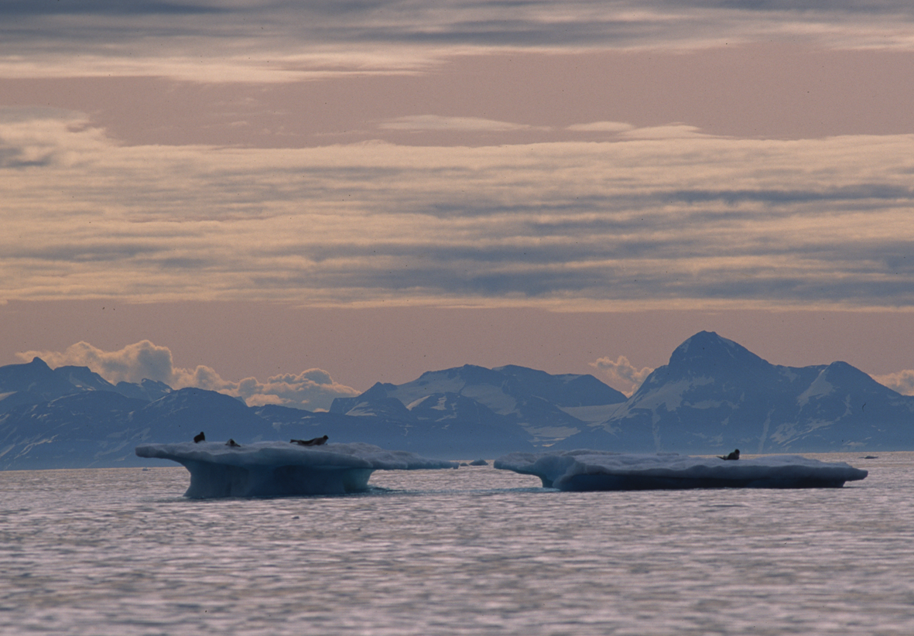
Management Committee for Seals and Walrus
Aqqalu Rosing-Asvid (GL)
Vice Chair SC

Slide 2
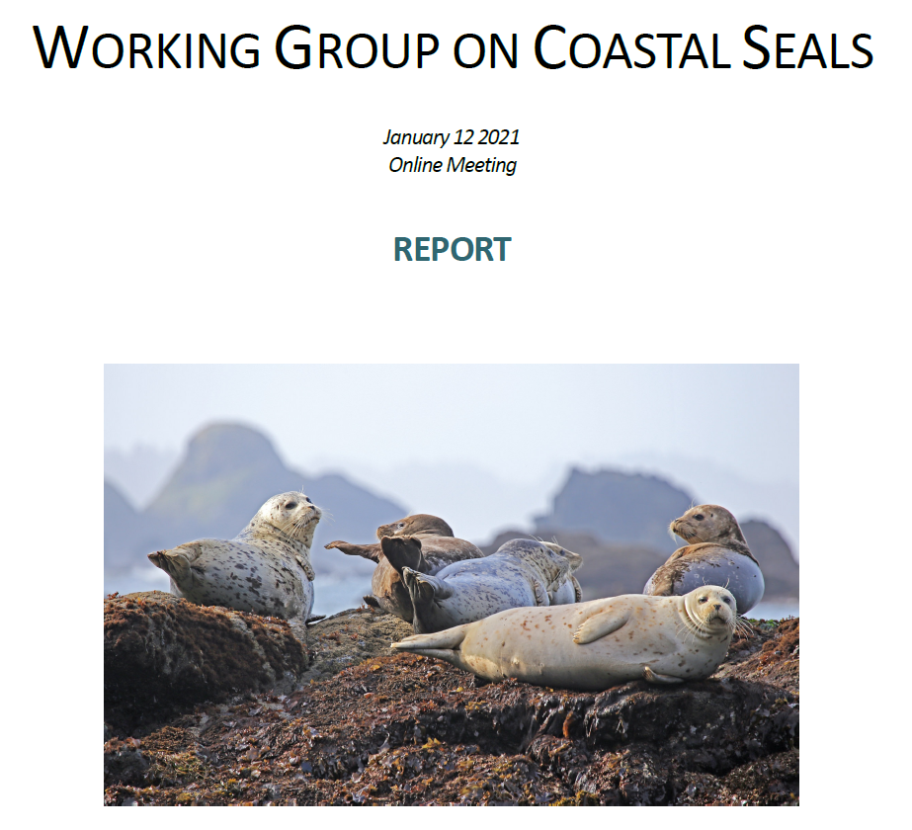

Slide 3
Status of Harbour Seals
Norway and Greenland
Status of Grey Seals
Norway and Faroe Islands

Slide 4
2011–2015

Slide 5
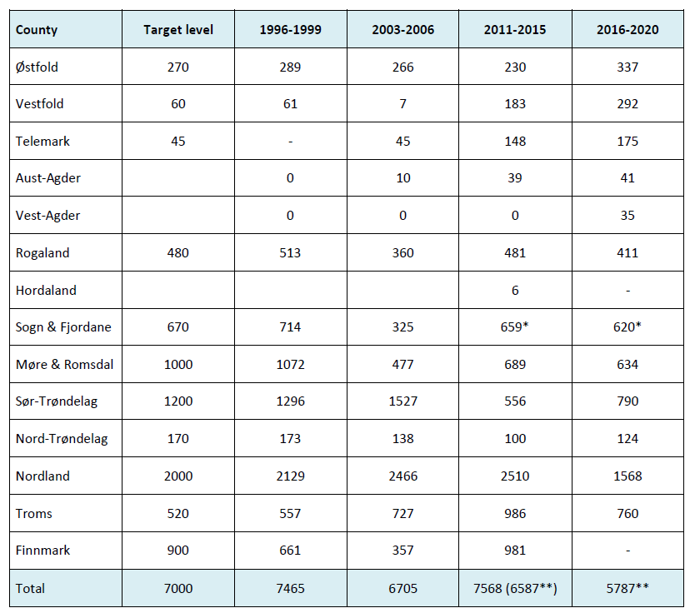
**Not including Finnmark.

Slide 6
2011–2015
Recommendations for Research
Complete the collection and analysis of DNA samples from
harbour seal pups in Norway to help determine
stock structure and propose more scientifically based management units.

Slide 7
Breeding Sites
Dissapeared
Prior to 1976
Dissapeared
1976 - 1990
Active 1990

Slide 8
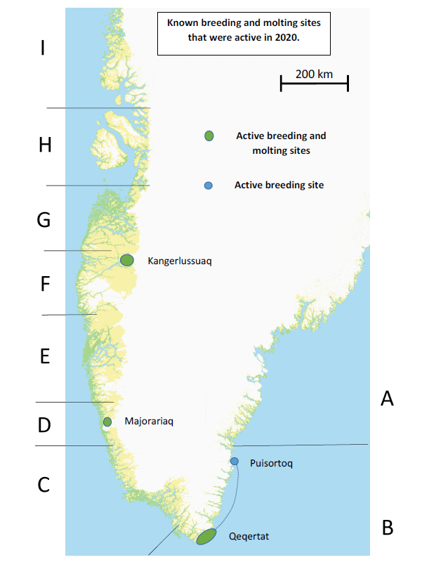

Slide 9
Period | Max. Number seen. | References
Early 1960s | 5-600 | Teilmann and Dietz 1993
1995 | 7 | Lisborg et al. 1999
1996 | 6 | Lisborg et al. 1999
1997 | 6 | Lisborg et al. 1999
2009 | 7 | Pers. Com.
2010 | 3 | Rosing-Asvid
2011 | 3 | Pers. Com.
2013 | 5 (2 pups) | (intervievs Kangaamiut).
2018 | 5 (2 pups) | Current monitoring
2019 | 3 (1 pup) | Current monitoring
2020 | 3 (1 pup) | Current monitoring

Slide 10
Majorariaq | Single adult | Mother – Pup pairs | Juvenile
19. juni 2013 | 2 | 3-3 | 0
12. juni 2014 | 2 | 4-4 | 2
23. juni 2020 | 17-19

Slide 11
Cape Farwell area | Max. no
August 2009 | 32
August 2019 | 42 +

Slide 12
Recommendations for Research
Enhance efforts to identify new whelping and moulting sites
for harbour seals in Greenland

Slide 13
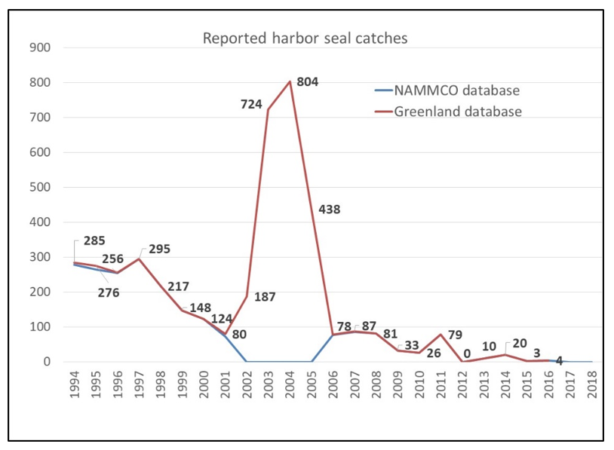
A note on the Greenland harbor seal catch statistics

Slide 14
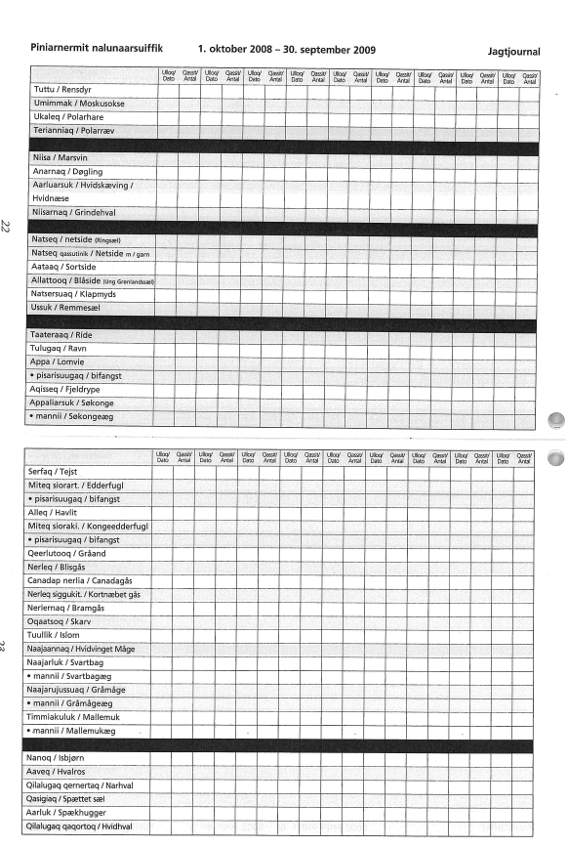
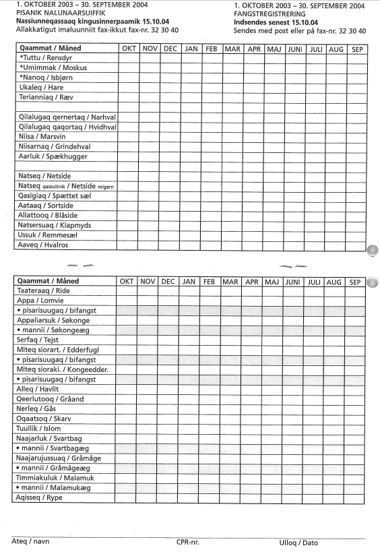

Slide 15
A note on the Greenland harbor seal catch statistics
Upernavik 252
Tasiilaq 143
Upernavik 1
Tasiilaq 0
79 catches 29 correct 50 wrong

Slide 16
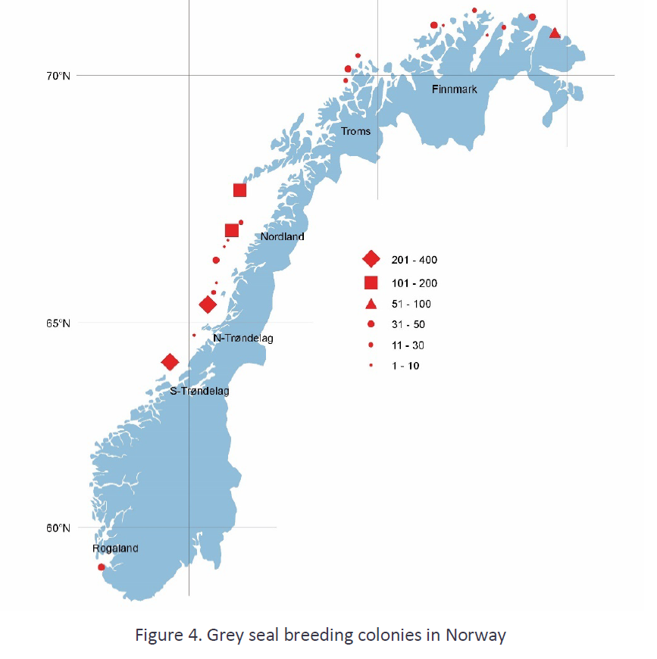
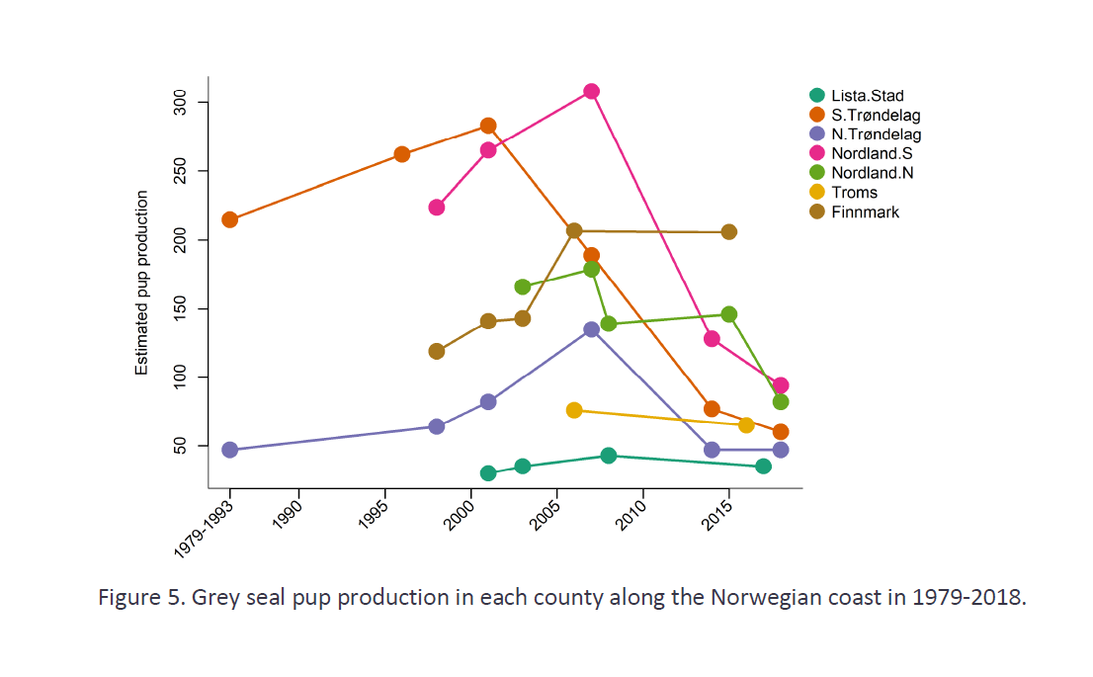
Model runs 2011: 7120 (5710–8540) animals (1+).
2016: 3850 (3504–4196) all animals
Next model run when survey cycle ends in 2021
1200 pups
(2008)
1979-2018.

Slide 17
Reason for the decline: Most likely to be by-catch especially in the monkfish fishery
5 tagged pups were all were by-caught.
Factors that influence the assessment of the situation:
Lack of confidence in species identification of by-caught seals.
The assumption that there is a high level of migration from populations in the UK and Russia into certain areas.
The CSWG recommended to re-evaluate the accuracy of the proposed migration rates by reviewing telemetry data from the UK and Russia and performing DNA analysis on pups and to support ongoing effort to expand grey seal population modelling to a Europe wide scale, to be able to account for migration between the different populations.

Slide 18
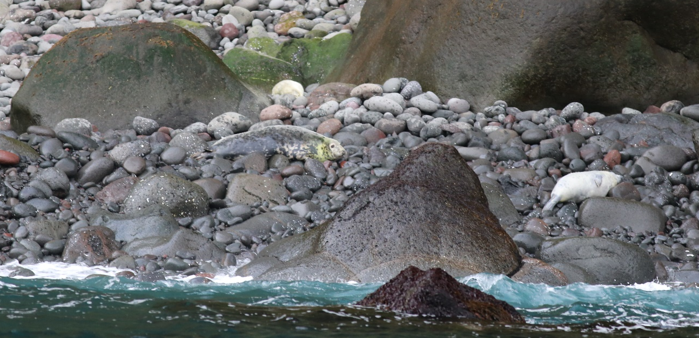
The Faroese grey seal stock has now been counted,
for the first time ever, to number a minimum of 550 animals.
Summer haul-out counts

Slide 19
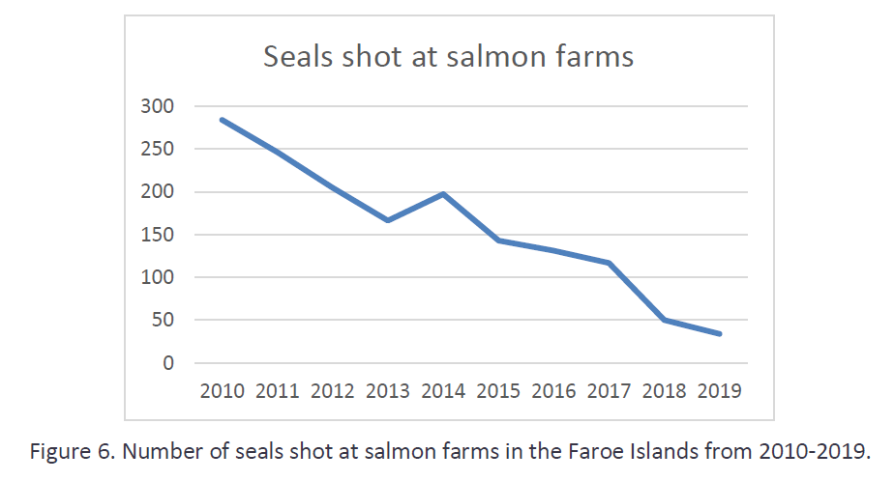
Harvest levels have steadily declined from more than 200 animals a year, to nearly zero mortality,
due to a new law, prohibiting the intentional killing of marine mammals around fish farms.

Slide 20
First count – no trend yet, but the ban on culling of grey seals round fish farms
is assumed to allow the population to recover.
Plans: To repeat the counts on a regular basis,
To conduct a telemetry study to estimate correction factors for seals outside the assessment areas,
To monitor the largest haul-out sites by cameras to investigate haul-out behavior and the variation in the
number of animals present at haul-out sites.
The WG supported the proposed plan.
The NAMMCO SC endorsed all the recommendations made by the CSWG

