Slide 1
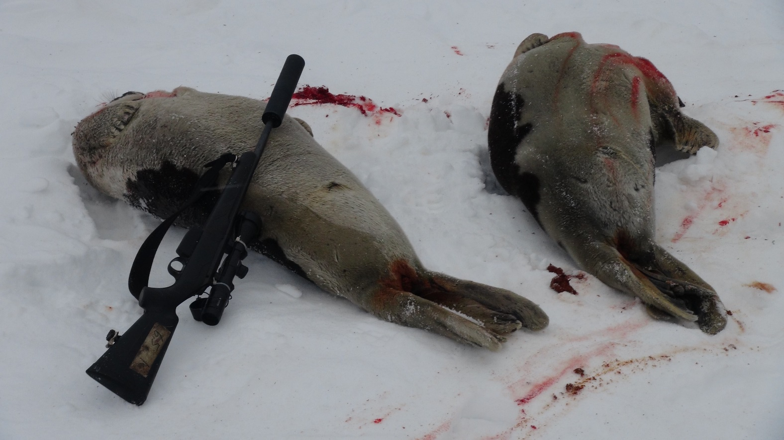
Committee on Hunting Methods
Kathrine A. Ryeng (NO)
Chair
Photo: KA Ryeng

Slide 2
1. meetings and members
CHM meetings
2019: 3 October (Copenhagen)
2020: 9 February (Hafnarfjörður), 11 June and 14-15 October (Online)
2021: 23 and 25 February (Online)
Committee members
FO: Signar Pettersen and Ulla Svarrer Wang
GL: Sofie Abelsen, Jesper Ødegaard Jakobsen, Amalie Jessen and Nette Levermann (to July 2020)
IS: Guðni Magnús Eiríksson and Kristján Loftsson
NO: Guro Gjelsvik (from 2021), Kathrine A. Ryeng and Hild Ynnesdal

Slide 3
2. Main discussions and DECISIONS
2.1 WORKSHOP/EXPERT GROUP MEETING
2.2 INSTRUCTION videos for marine mammal hunters
2.3 Including presentations from hunters in the COMMITTEE meetings
2.4 ACTIVE RECOMMENDATIONS AND FOLLOW UP
2.5 PANEL REVIEW RECOMMENDATIONS
2.6 WEBSITE – QUALITY CHECK
2.7 Update on regulations and references
2.8 DATABASE and DATA REQUIREMENTS
2.9 WORKPLAN 2021 – 2022

Slide 4
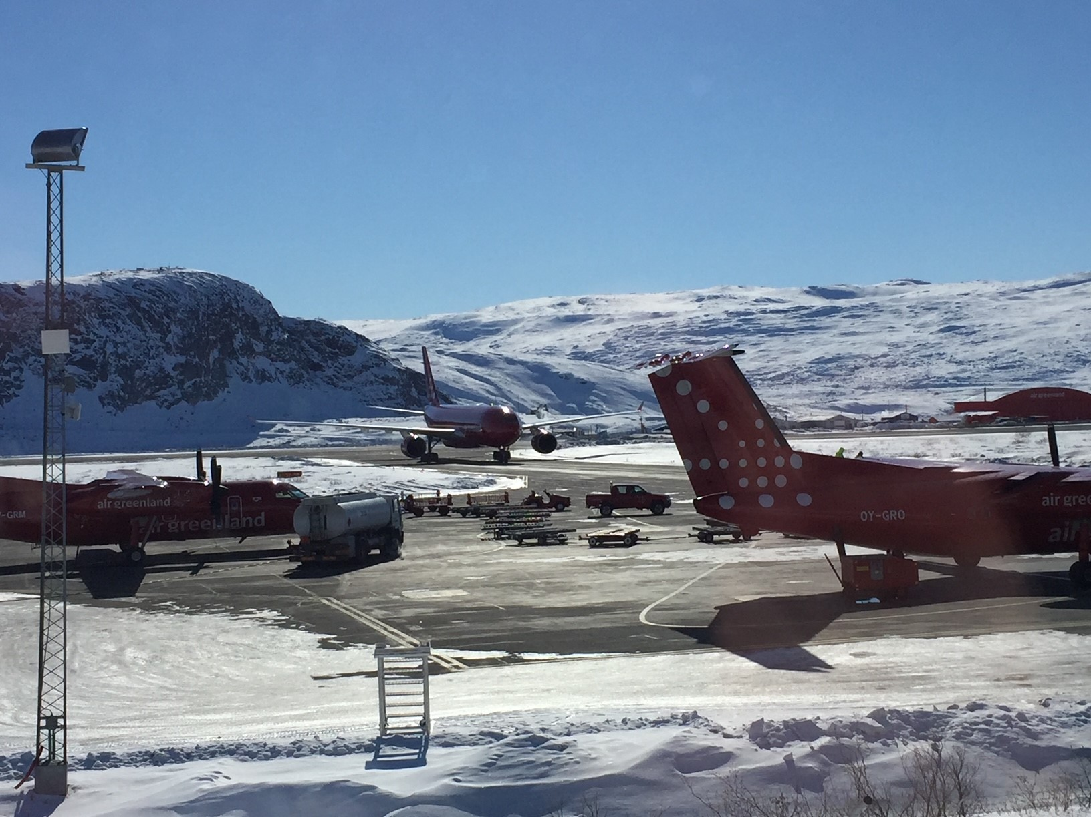
2.1 WORKSHOP/EXPERT GROUP MEETING
The Council 27 had endorsed the proposal to convene two events:
  An Expert Group meeting (EGM) on hunting efficiency of small cetaceans as a follow up to the 2011 EGM
  A Workshop or EGM on methods where the combined use of harpoon and rifle is not one weapon
The CHM decided to combine the two events
  Focusing on methods to improve animal welfare in hunts for all marine mammals where harpoon and rifle is not one weapon, i.e. all small cetaceans, seals and minke whales
Given that these are all hunts that take place in Greenland, CHM agreed to recommend holding the WS/EGM in Greenland in 2021
The CHM continued the work of organising the WS/EGM through 2019 and up to Sept 2020
Photo: KA Ryeng

Slide 5
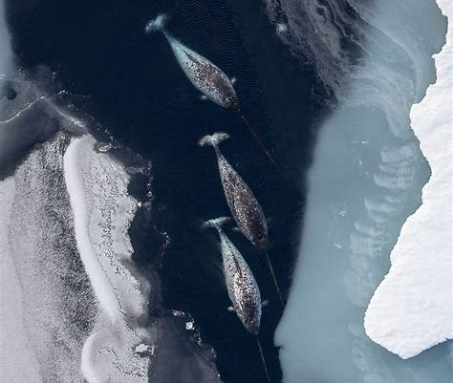
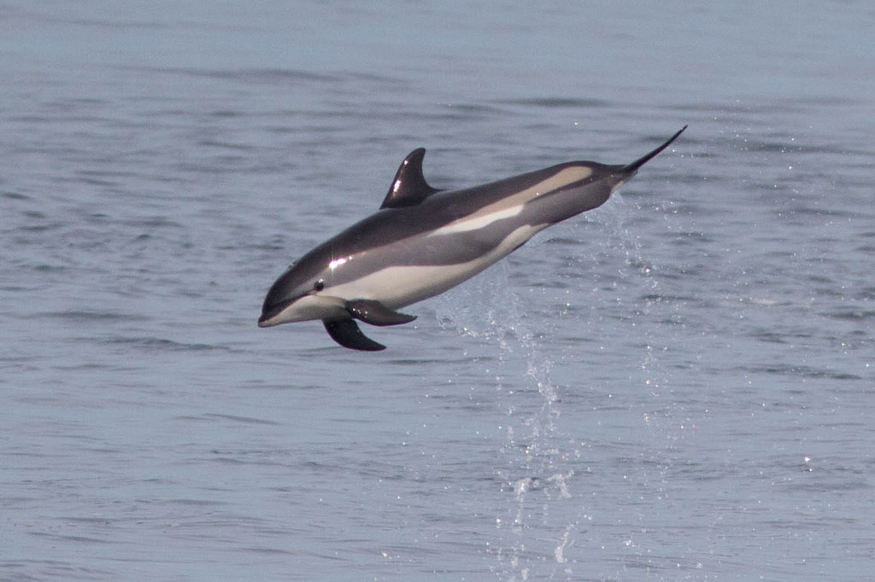
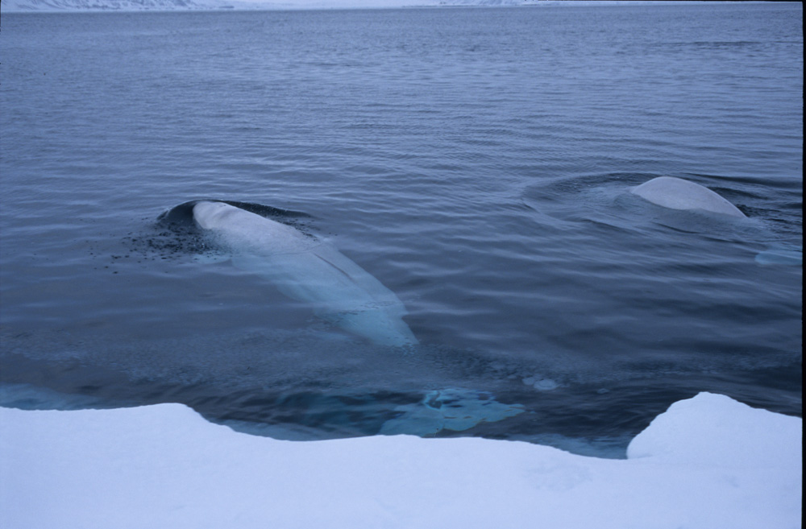
2.1 WORKSHOP/EXPERT GROUP
MEETING
Sept 2020:
  Due to personnel changes and the pandemic, Greenland informed NAMMCO it would not be able to allocate the required resources to ensure a successful outcome of the meeting
  The Council-HoDs meeting agreed to postpone the event
  The CHM has put the meeting on hold until it is feasible to convene the meeting
Related to the discussions of the WS/EGM, the CHM has recommended
  Greenland to finalise the analysis of TTD data for beluga and narwhal
  The Faroe Islands to undertake structured examinations and develop a spinal lance blade that will improve the dolphin hunt
Photo: Norwegian Polar Institute
Photo: NAMMCO
Photo: Norwegian Polar Institute

Slide 6
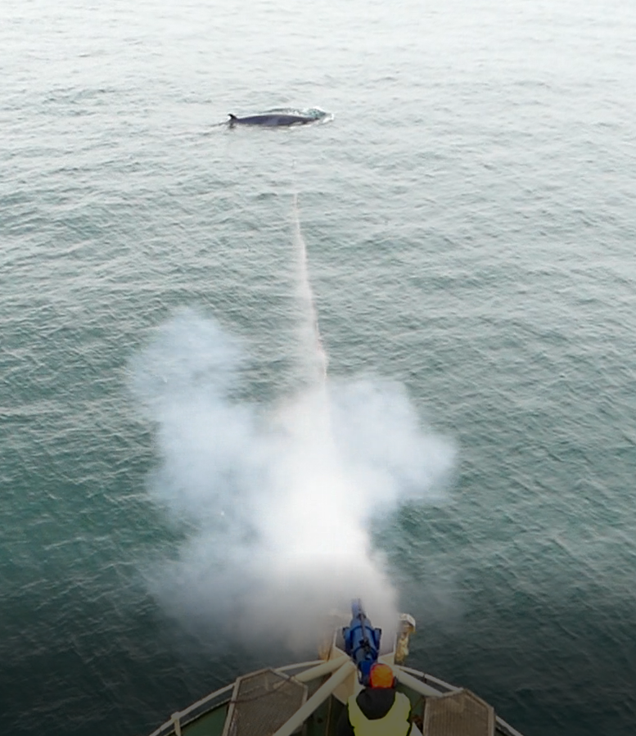
2.2 INSTRUCTION videos for marine mammal hunters
The CHM discussed a proposal put forward by the Secretariat of producing short training videos
These videos could be seen as an extension of the manuals developed in 2013 and the Greenlandic animation video on the penthrite grenade
The proposal is to produce a series of short professional training videos for hunters:
  Easily accessible on the NAMMCO website
  Have an English version as well as versions in the native language of the hunters
  Illustrate technical information regarding the weapons and their use and maintenance
  Optimal target sites and shooting angles
It is envisaged to use a combination of animation, illustrations, and filmed footage
To be user friendly, the video(s) should be short, professionally produced, and cover different aspects of hunting operations
The videos could become an integrated part of the hunters’ training courses
Extending this project to include other hunting nations
Photo: KA Ryeng

Slide 7

2.2 INSTRUCTION videos for marine mammal hunters
The CHM welcomed the initiative and agreed to recommend to Council to make an
Instruction video on safe handling of the whaling gun (cannon) with shell (cartridge), the harpoon and the explosive grenade
The CHM considered such a video as potentially the first of several future instruction videos
A series of videos would, however, be a long-time endeavour where the content and financial implications would be discussed and forwarded to Council for approval as appropriate

Slide 8
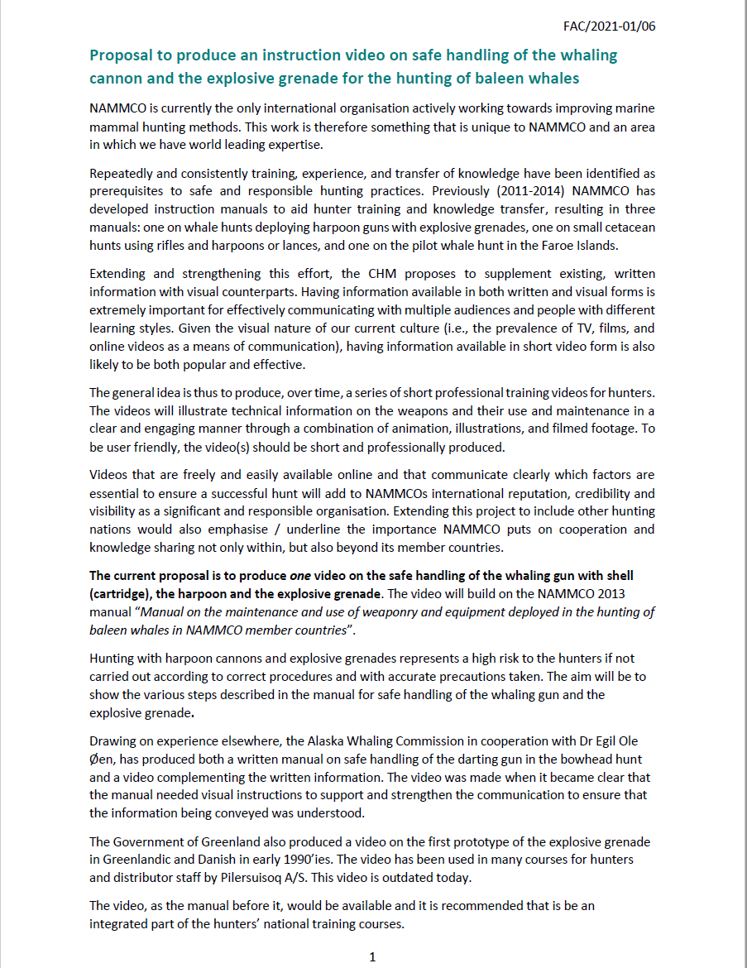
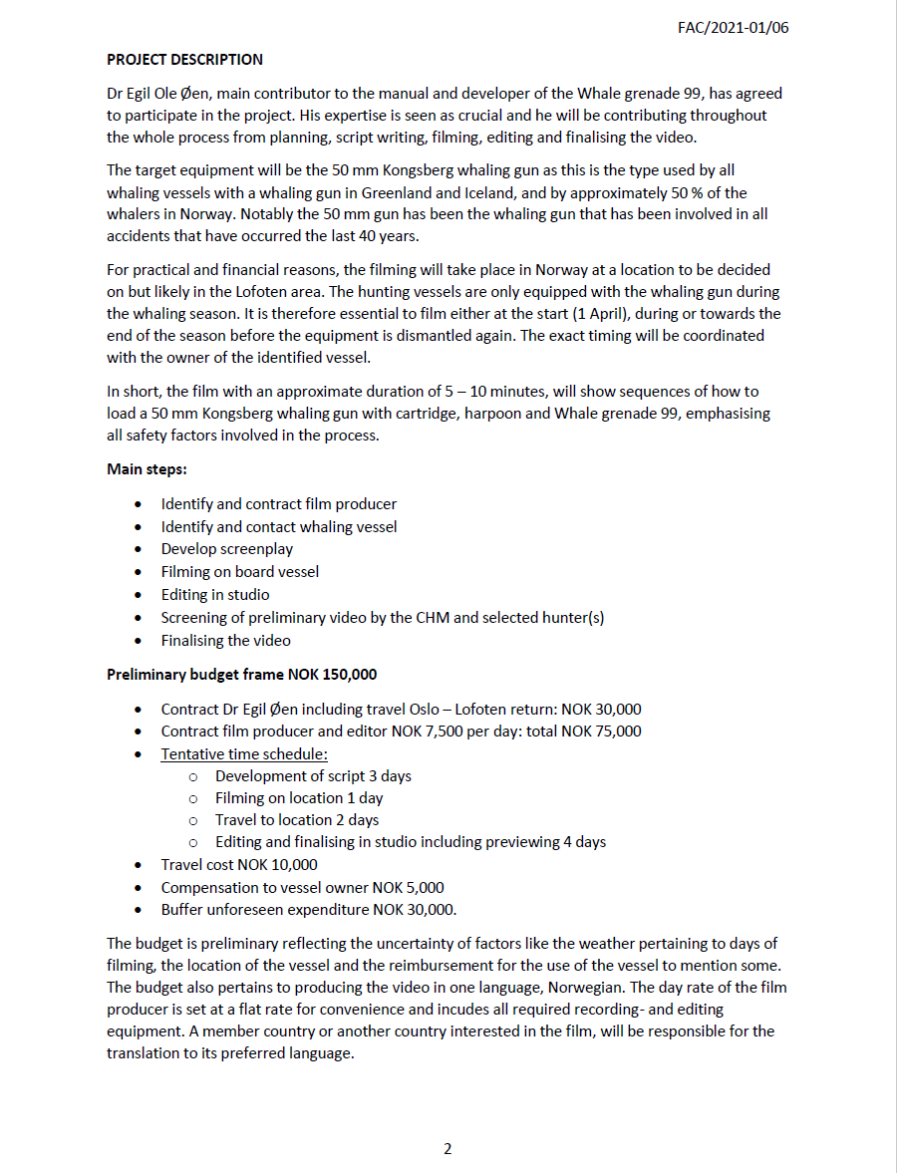
2.2 INSTRUCTION videos for marine mammal hunters
Proposal to produce a video on the safe handling of the whaling gun (cannon) with shell (cartridge), the harpoon and the explosive grenade (Appendix 2)
Hunting with harpoon cannons and explosive grenades represents a high risk to the hunters if not carried out according to correct procedures and with accurate precautions taken
Dr Egil Ole Øen, the main contributor to the manual and developer of the Whale grenade 99, has agreed to participate in the project
His expertise is seen as crucial and he will be contributing throughout the whole process from planning, script writing, filming, editing and finalising the video

Slide 9
2.2 INSTRUCTION videos for marine mammal hunters
Target equipment:
  The 50 mm Kongsberg whaling gun (cannon)
  Is used by all whaling vessels with a whaling gun (cannon) in Greenland and Iceland, and by approximately 50 % of the whalers in Norway
The film:
  Approximate duration of 5 – 10 minutes
  Will show sequences of how to load a 50 mm Kongsberg whaling gun (cannon) with cartridge, harpoon and Whale grenade 99
  Emphasizing all safety factors involved in the process
  Language: Norwegian
  Member countries (or other) interested in the film, will be responsible for the translation to its preferred language
50 mm Kongsberg hvalkanon med harpun og Hvalgranat–99 klar til skudd.
Foto: Björgvin Guðmundsson

Slide 10
2.2 INSTRUCTION videos for marine mammal hunters
Main steps:
• Identify and contract film producer
• Identify and contact whaling vessel
• Develop screenplay
• Filming on board vessel
• Editing in studio
• Screening of preliminary video by the CHM and selected hunter(s)
• Finalising the video
Preliminary budget frame NOK 150,000, including unforeseen expenditure of NOK 30,000
50 mm Kongsberg hvalkanon med harpun og Hvalgranat–99 klar til skudd
Foto: Björgvin Guðmundsson

Slide 11
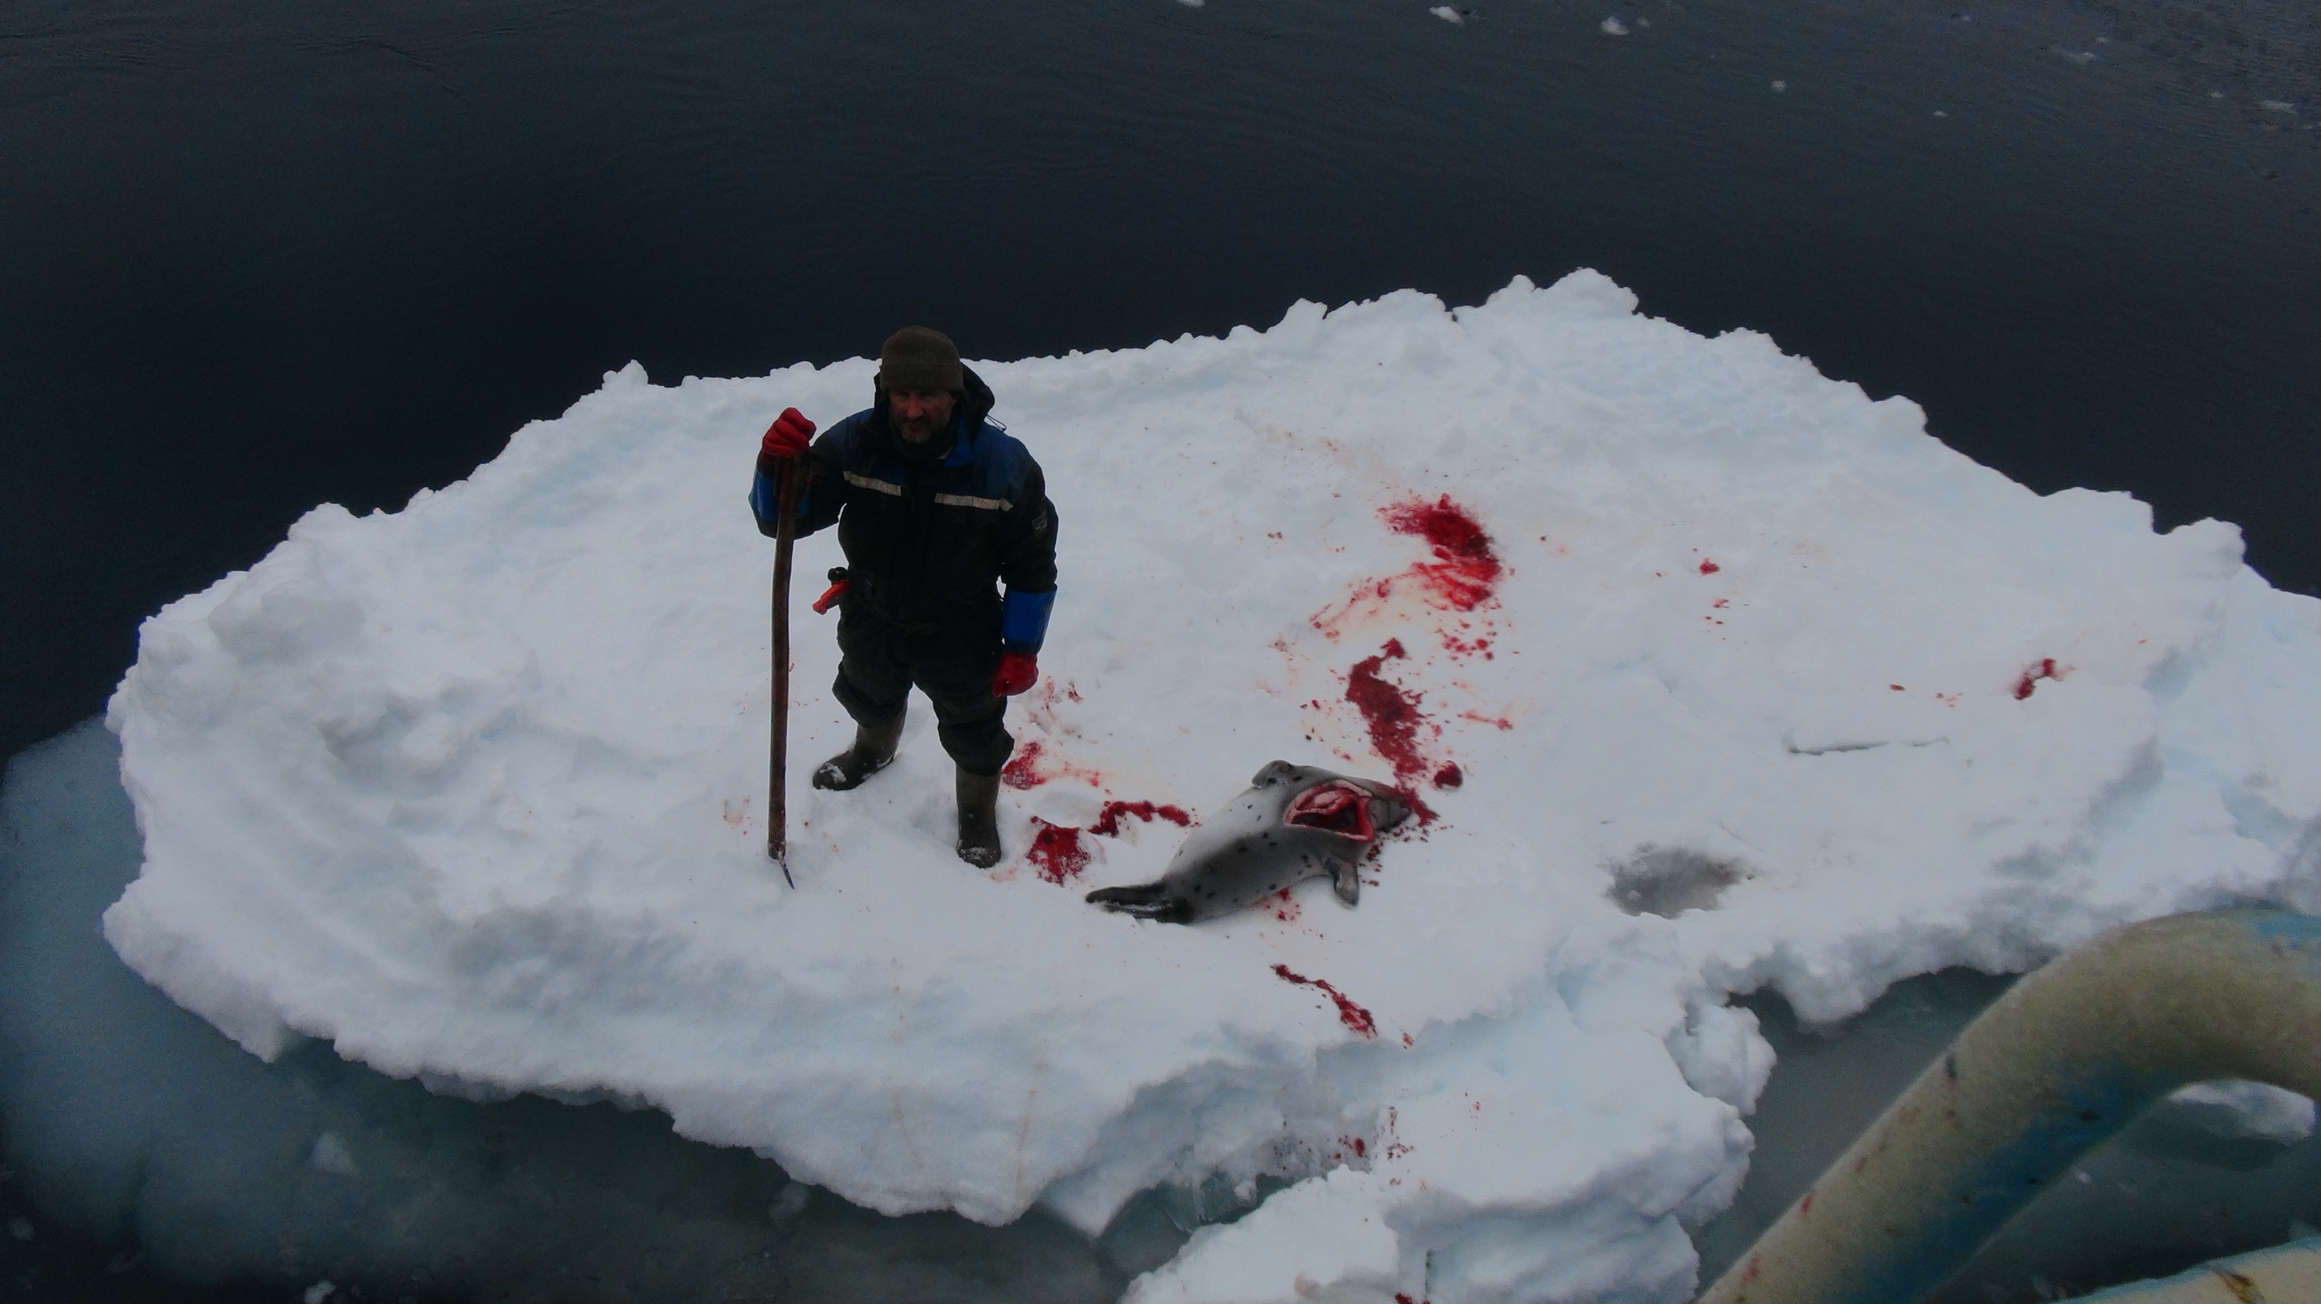
2.3 Including presentations from hunters in the COMMITTEE meetings
The CHM noted that
  the online meeting platforms represented an interesting avenue for new ways of acquiring information and conducting meetings
  a wealth of information is available in reports from Workshops and Expert Group meetings on hunting methods
  it might be particularly helpful for new members to learn how hunts are being carried out directly from hunters
The CHM agreed to
  invite hunters from different hunt to share their expertise on a particular hunt during online CHM meetings
It was acknowledged that it might not be feasible to get input from all hunts taking place in NAMMCO due to technical and translation challenges
It was agreed that Norway be tasked with identifying a hunter to present either sealing or whaling operations at either the next, or a special meeting
Photo: KA Ryeng

Slide 12
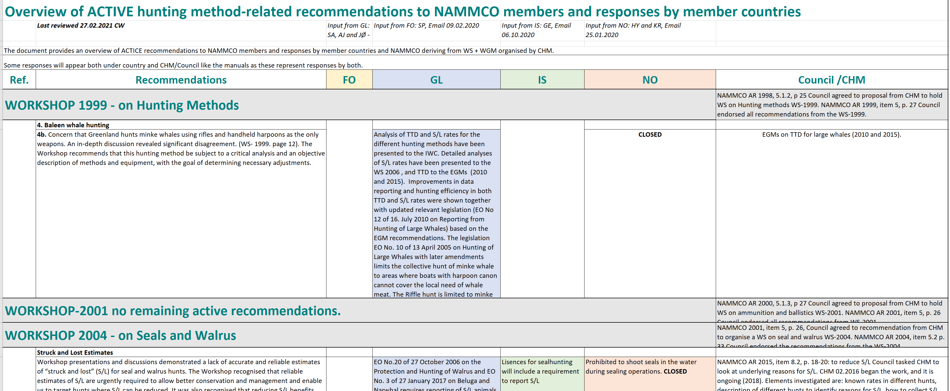
2.4 ACTIVE RECOMMENDATIONS AND FOLLOW UP
Recommendations to member countries from all Expert Group meetings and Workshops organised by the committee since 1999 has been compiled, including member country responses
The CHM has concluded a review process of these recommendations, identifying recommendations that were completed/closed and active ones
Within the remaining active recommendations, the following overall categories have been identified:
  Recommendations pertaining to struck and lost issues,
  Recommendations pertaining to the municipal rifle hunt in Greenland,
  Recommendations pertaining to training/education and safety issues for hunters
As a next step, the Chair and the Secretariat will compile and structure those active recommendations belonging to one of the abovementioned categories together to simplify the overview for future reference

Slide 13
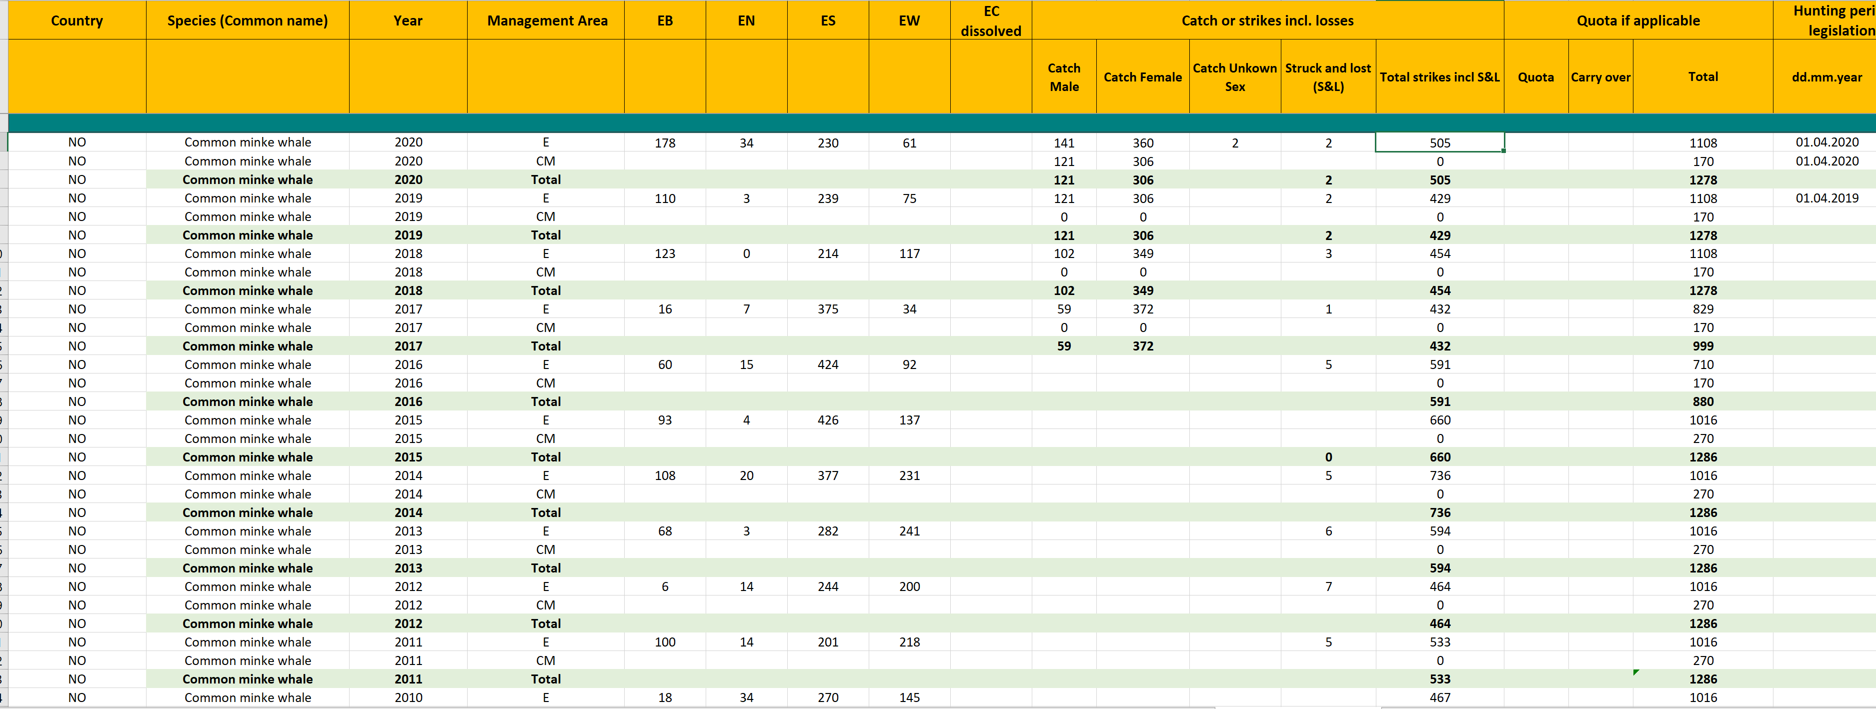
2.8 DATABASE and DATA REQUIREMENTS
The CHM has discussed and finalised the annual data requirements pertaining to data such as catch, stuck and lost, hunting periods, hunting methods and effort
Member countries have submitted their 2019 and 2020 data accordingly

Slide 14

2.9 WORKPLAN 2021 – 2022
2021
  Continue the review of active recommendations
  Produce the instruction video on safe handling of the whaling gun (cannon) with shell (cartridge), the harpoon and the explosive grenade, if given approval from the Council
2022
  Monitor annual reporting from member countries
  Identifying possible new video projects to present to Council

Slide 15

Action requested
To note the reports and consider the forwarded recommendations:
  Greenland to carry out analysis of TTD for beluga and narwhal
  The Faroe Islands to develop a spinal lance blade to improve the dolphin hunt
  To develop an instruction video on safe handling of the whaling gun (cannon), the harpoon and the explosive grenade
  To develop ideas of additional instruction videos to be presented to Council for future consideration

